Slide 1
B+ Trees

Slide 2
Multiway (M-way) Trees
The m-way search trees are self-balanced trees used to search or retrieve data efficiently. m represents the maximum number of children for a node in the tree. Binary trees are also called 2-way search trees as they have a maximum of two children.
Given the nonempty multiway tree, the following properties are defined:
Each node has 0 to m subtrees.
Given a node contains k subtree pointers, some of which may be null, and k-1 data entries.
The key values in the first subtree are all less than the key in the first entry, the key values in the other subtrees are all greater than or equal to the key in their parent entry
The keys of the data entries are ordered.

Slide 3
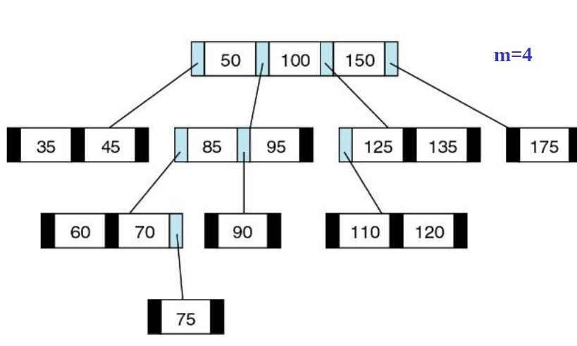
Example for M-way Tree

Slide 4
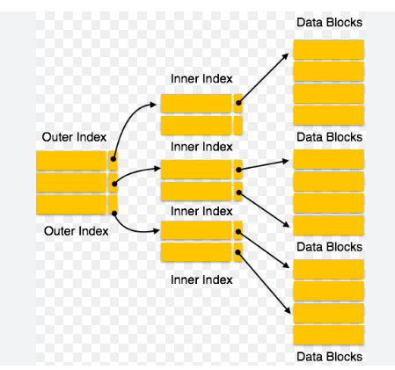
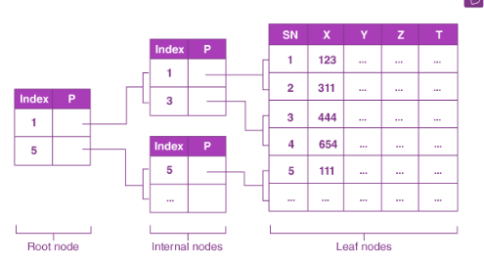
Multilevel indexing
Multilevel indexes refer to a hierarchical structure of indexes. Here, each level of the index provides a more detailed reference to the data. It allows faster data retrieval, reduces disk access, and improves query performance

Slide 5
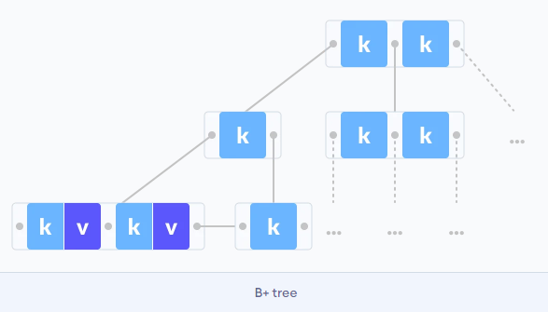
B+ Tree
A B+ tree is an advanced form of a self-balancing tree in which all the values are present in the leaf level.
An important concept to be understood before learning B+ tree is multilevel indexing. In multilevel indexing, the index of indices is created as in figure below. It makes accessing the data easier and faster.
Structure of B+ Tree

Slide 6
Features of B+ Trees
Balanced: B+ Trees are self-balancing, which means that as data is added or removed from the tree, it automatically adjusts itself to maintain a balanced structure. This ensures that the search time remains relatively constant, regardless of the size of the tree.
Multi-level : B+ Trees are multi-level data structures, with a root node at the top and one or more levels of internal nodes below it. The leaf nodes at the bottom level contain the actual data.
Ordered: B+ Trees maintain the order of the keys in the tree, which makes it easy to perform range queries and other operations that require sorted data.
Fan-out: B+ Trees have a high fan-out, which means that each node can have many child nodes. This reduces the height of the tree and increases the efficiency of searching and indexing operations.
Cache-friendly: B+ Trees are designed to be cache-friendly, which means that they can take advantage of the caching mechanisms in modern computer architectures to improve performance.
Disk-oriented: B+ Trees are often used for disk-based storage systems because they are efficient at storing and retrieving data from disk.

Slide 7
Why Use B+ Tree?
B+ Trees are the best choice for storage systems with sluggish data access because they minimize I/O operations while facilitating efficient disc access.
B+ Trees are a good choice for database systems and applications needing quick data retrieval because of their balanced structure, which guarantees predictable performance for a variety of activities and facilitates effective range-based queries.

Slide 8
Advantage of B+ Tree over Binary Search Tree
BST stores lesser data in a node as compared to B+ Trees. This results in the increased height of BST than B+ trees. So they are stored on the disk rather than RAM.
The major advantage of the B+ tree (and B-trees in general) over binary search trees is that they play well with caches. If you have a binary search tree whose nodes are stored in more or less random order in memory, then each time you follow a pointer, the machine will have to pull in a new block of memory into the processor cache, which is dramatically slower than accessing memory already in cache.
Every time data has to be retrieved from the tree, the data from the disk has to be loaded into the main memory(which is, of course, a time-consuming process) while, in case of B+ trees, the data is already there in RAM and the required node is fetched directly and data is retrieved from that node which may contain many children(but the overall time for data retrieval is lesser in case of B+ trees because there is no need of loading data from disk to RAM).

Slide 9
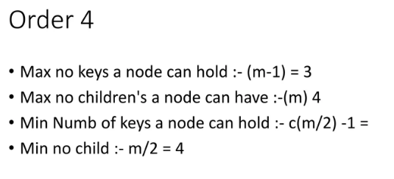
Properties of a B+ Tree
All leaves are at the same level.
The root has at least two children.
Each node except root can have a maximum of m children and at least m/2 children.
Each node can contain a maximum of m - 1 keys and a minimum of ⌈m/2⌉ - 1 keys.

Slide 10
Searching in B+ Tree
The following steps are followed to search for data in a B+ Tree of order m. Let the data to be searched be k.
Start from the root node. Compare k with the keys at the root node [k1, k2, k3,......km - 1].
If k < k1, go to the left child of the root node.
Else if k == k1, compare k2. If k < k2, k lies between k1 and k2. So, search in the left child of k2.
If k > k2, go for k3, k4,...km-1 as in steps 2 and 3.
Repeat the above steps until a leaf node is reached.
If k exists in the leaf node, return true else return false.

Slide 11
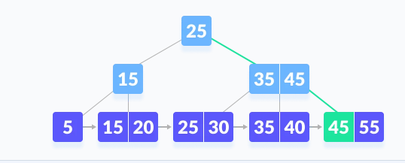



Example of Searching in B+ Tree
Search 45

Slide 12
Insertion in B+ Tree
Inserting an element into a B+ tree consists of three main events: searching the appropriate leaf, inserting the element and balancing/splitting the tree. The following steps are followed for inserting an element:
Since every element is inserted into the leaf node, go to the appropriate leaf node.
Insert the key into the leaf node.
Case I
If the leaf is not full, insert the key into the leaf node in increasing order.
Case II
If the leaf is full, insert the key into the leaf node in increasing order and balance the tree in the following way.
Break the node at m/2th position.
Add m/2th key to the parent node as well.
If the parent node is already full, follow steps 2 to 3.

Slide 13

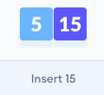
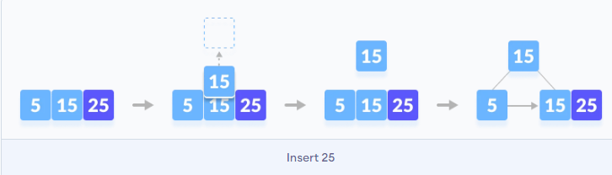

Example of B+ tree insertion order m=3
Insert 5,15, 25

Slide 14
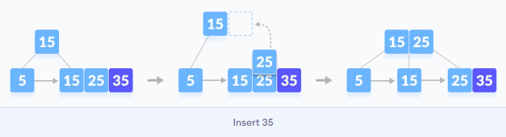
Insert 35

Slide 15
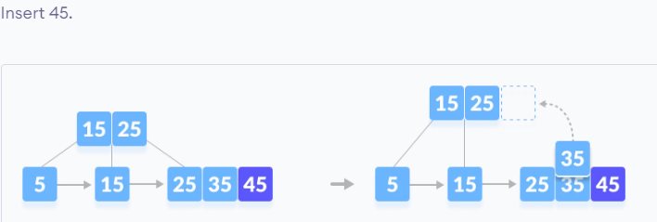
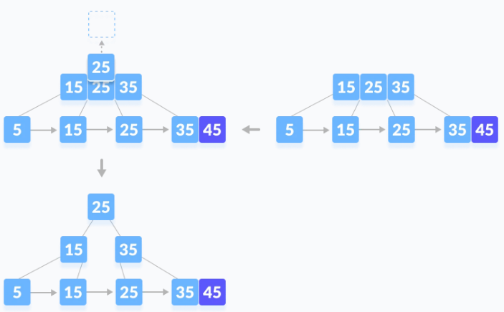
Insert 45

Slide 16
Deletion from a B-tree
Deleting an element on a B+ tree consists of three main events:
Searching the node where the key to be deleted exists, deleting the key and balancing the tree if required.
Underflow is a situation when there is a smaller number of keys in a node than the minimum number of keys it should hold.
Case I: The key to be deleted is present only at the leaf node not in the indexes (or internal nodes).
Case II - The key to be deleted is present in the internal nodes as well. Then we have to remove them from the internal nodes as well.
Case III : In this case, the height of the tree gets shrinked.

Slide 17
Deletion in B+ trees
Case I: The key to be deleted is present only at the leaf node not in the indexes (or internal nodes).
There are two cases for it:
There is more than the minimum number of keys in the node. Simply delete the key.
There is an exact minimum number of keys in the node. Delete the key and borrow a key from the immediate sibling. Add the median key of the sibling node to the parent.

Slide 18
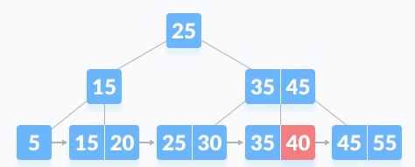
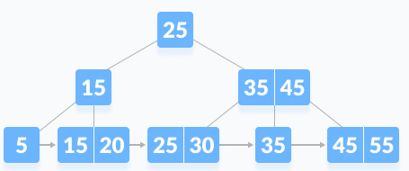
Deletion in B+ trees
Case I: The key to be deleted is present only at the leaf node not in the indexes (or internal nodes).
There is more than the minimum number of keys in the node. Simply delete the key.

Slide 19
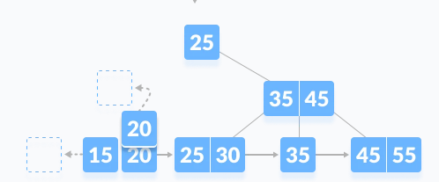
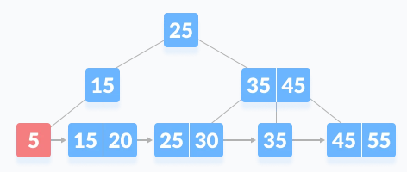
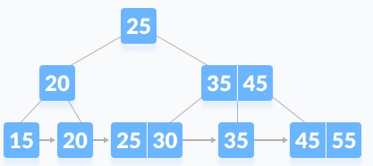
Deletion in B+ trees
Case I: The key to be deleted is present only at the leaf node not in the indexes (or internal nodes).
There is an exact minimum number of keys in the node. Delete the key and borrow a key from the immediate sibling. Add the median key of the sibling node to the parent.

Slide 20
Deletion in B+ tree
Case II - The key to be deleted is present in the internal nodes as well. Then we have to remove them from the internal nodes as well. There are the following cases for this situation.
If there is more than the minimum number of keys in the node, simply delete the key from the leaf node and delete the key from the internal node as well. Fill the empty space in the internal node with the in order successor.
If there is an exact minimum number of keys in the node, then delete the key and borrow a key from its immediate sibling (through the parent). Fill the empty space created in the index (internal node) with the borrowed key.
This case is similar to Case II(1) but here, empty space is generated above the immediate parent node. After deleting the key, merge the empty space with its sibling. Fill the empty space in the grandparent node with the inorder successor.

Slide 21
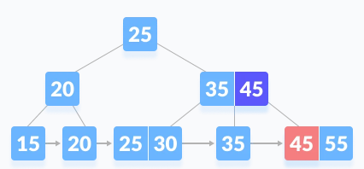
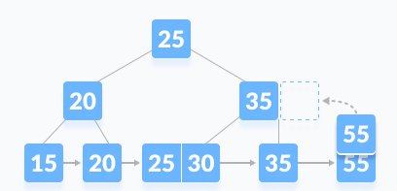
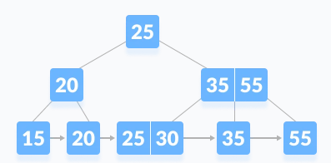
Deletion in B+ tree
Case II - The key to be deleted is present in the internal nodes as well. Then we have to remove them from the internal nodes as well. There are the following cases for this situation.
If there is more than the minimum number of keys in the node, simply delete the key from the leaf node and delete the key from the internal node as well. Fill the empty space in the internal node with the in order successor.

Slide 22
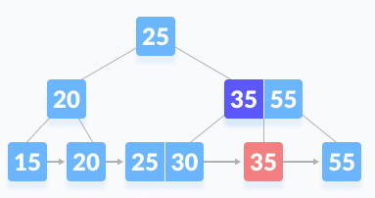
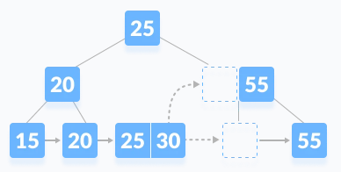
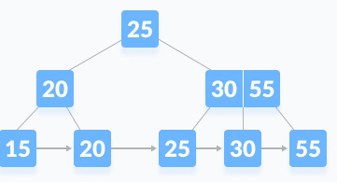
Deletion in B+ tree
Case II - The key to be deleted is present in the internal nodes as well. Then we have to remove them from the internal nodes as well. There are the following cases for this situation.
If there is an exact minimum number of keys in the node, then delete the key and borrow a key from its immediate sibling (through the parent). Fill the empty space created in the index (internal node) with the borrowed key.

Slide 23
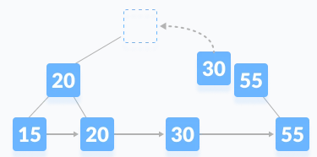
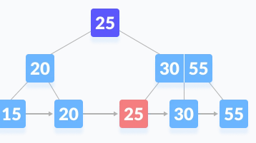
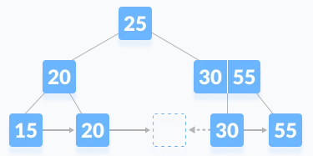
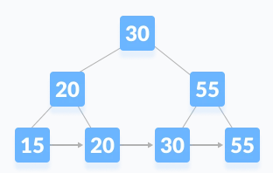
Deletion in B+ tree
Case II - The key to be deleted is present in the internal nodes as well. Then we have to remove them from the internal nodes as well. There are the following cases for this situation.
This case is similar to Case II(1) but here, empty space is generated above the immediate parent node. After deleting the key, merge the empty space with its sibling. Fill the empty space in the grandparent node with the inorder successor.

Slide 24
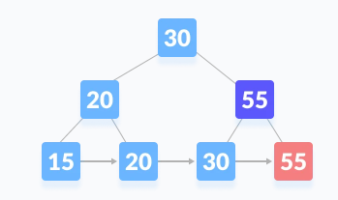
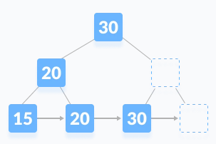
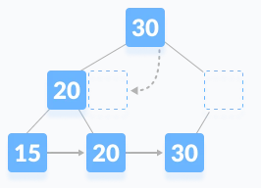
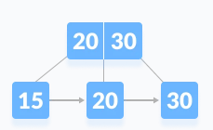
Deletion in B+ tree
Case III : In this case, the height of the tree gets shrinked. It is a little complicated. Deleting 55 from the tree below leads to this condition.

Slide 25
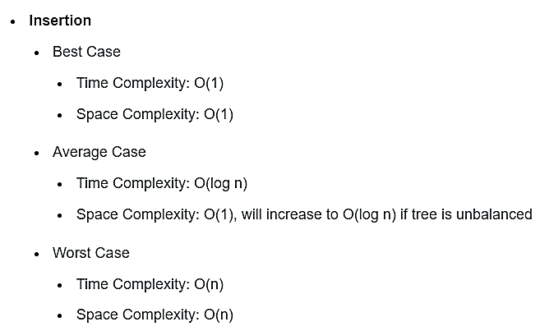
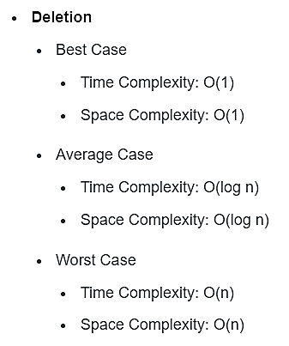
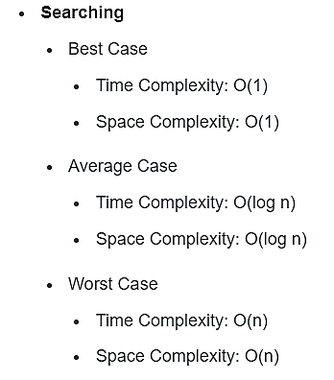
B+ tree operations - Time and Space Complexity

Slide 26
Reference
https://iq.opengenus.org/time-complexity-of-bplus-tree/
https://www.programiz.com/dsa/b-plus-tree
https://www.geeksforgeeks.org/introduction-of-b-tree/

